Slide 1
Cryptocurrency
Analysis
By: Saba Amin, Jacyntha Mack, and Nicolas Merced

Slide 2
Purpose
Predict trends of 5 different Cryptocurrencies by using past performance data in order to locate the most valuable investment.
Currencies Utilized:
Bitcoin
Dogecoin
Tether
Etherium
XRP

Slide 3
Tools Used
MongoDB
Jupyter Notebook
Yahoo Finance API
Tableau

Slide 4

BitCoin (BTC)
Created in 2009 with prices that exceeded $60,000 in 2021 by an unknown user/users with the pseudonym Satoshi Nakamoto
Digital currency that operated on a decentralized network.
Although transactions are recorded on a public log, users can remain anonymous with encryption keys.
Transactions are made with no need to go through a bank

Slide 5
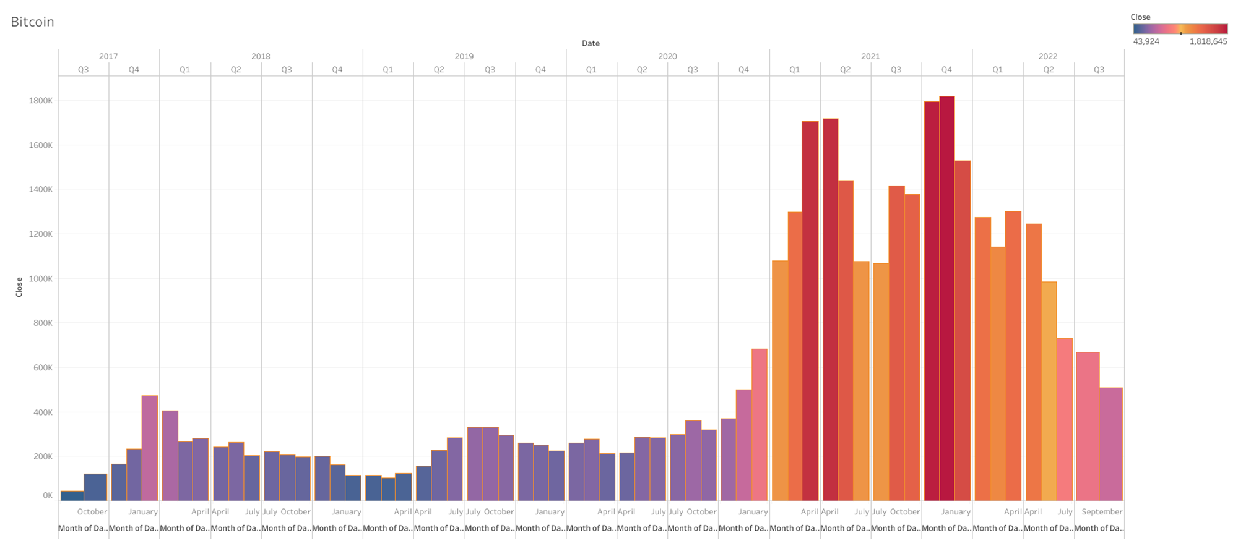
Bitcoin (BTC)
Notes:
This chart highlights Bitcoin’s Quarterly Performance since 2017

Slide 6

Dogecoin (DOGE)
Created in 2013 by Jackson Palmer, an Adobe Project Manager, as part of a satirical take on the crypto market.
Mined through a proof of work consensus algorithm where miners receive it as a ‘reward’ for solving blocks.
There is no cap on the amount of coin that can be mined, however, the coin has very few use cases.

Slide 7
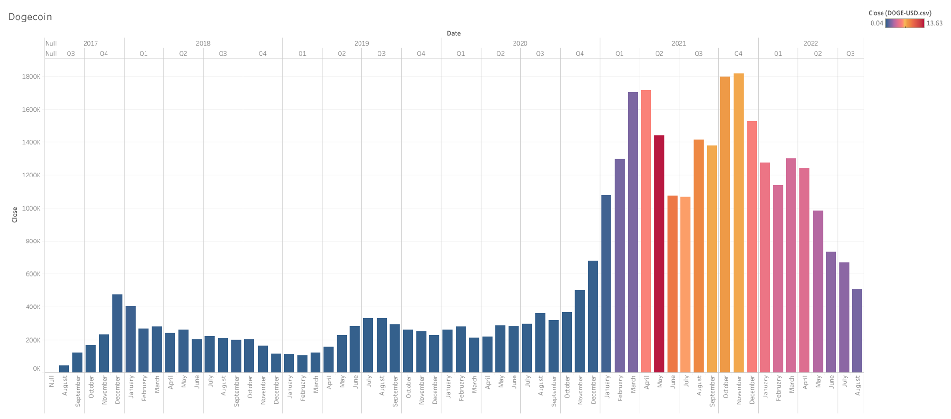
Dogecoin (DOGE)
Notes:
Dogecoin’s quarterly performance since 2017

Slide 8
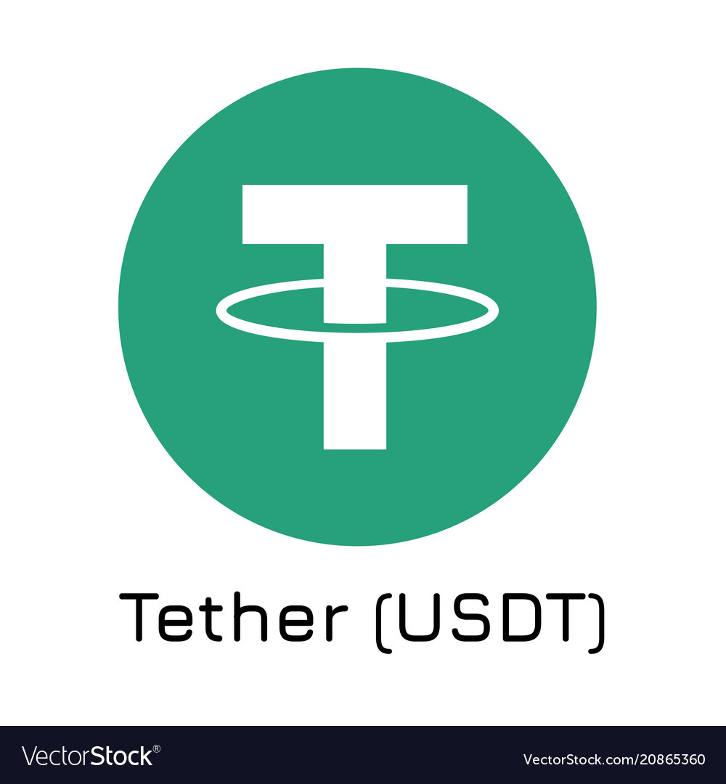
Tether (USDT)
Created in 2014, it was first issued as a dollar-backed digital currency known as realcoin through the Bitcoin network.
Also known as “stable coin” dues to its connection to real world assets such as the US dollar in order to maintain its value.
Some investors state that Tether may not have enough dollar reserves to justify its price making it a controversial currency.

Slide 9
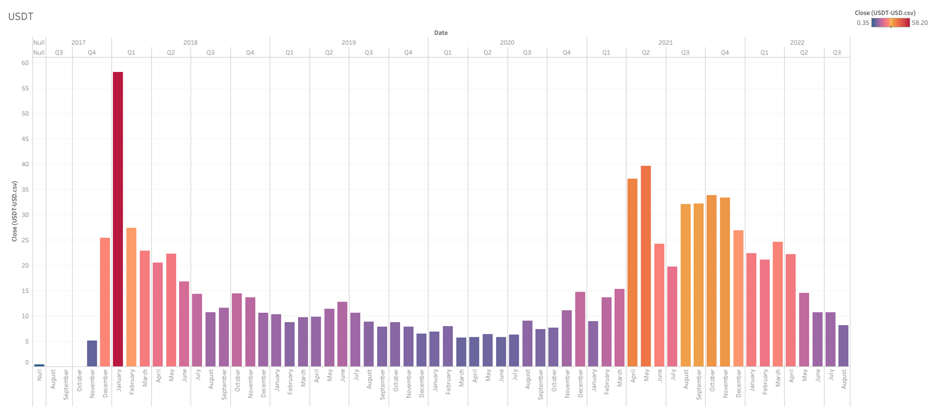
Tether (USDT)

Slide 10

Ethereum (ETH)
Launched in 2015 by Buterin and Joe Lubin, founders of the blockchain software company ConsenSys.
Uses a proof of work consensus protocol but is currently working toward a proof of stake protocol where owners “stake” a certain amount of their Ether.
The protocol will randomly choose users with stake in ether in order to verify their transactions with the reward being more ether; it serves as an incentive/collateral for the privilege of mining.

Slide 11
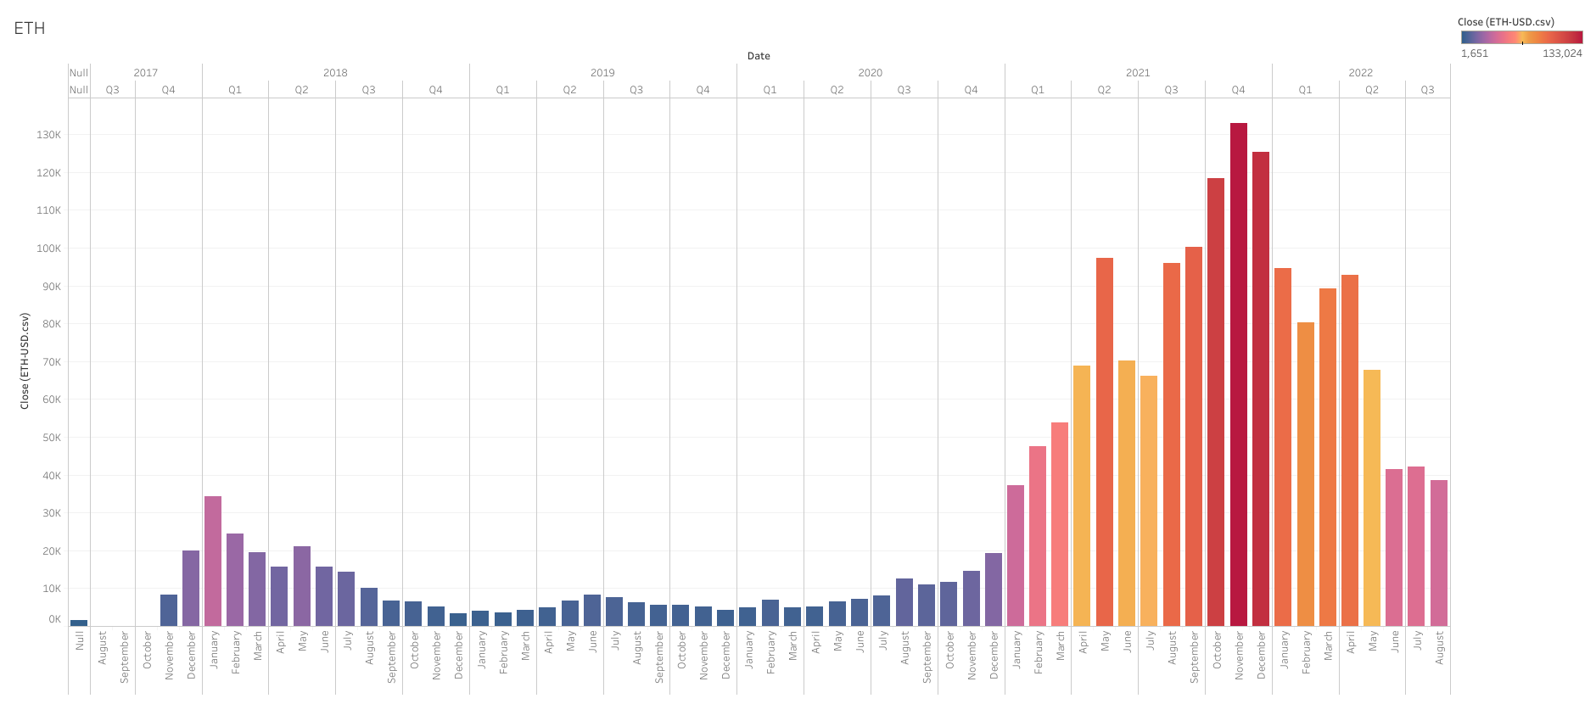
Ethereum (ETH)

Slide 12

XRP
Backed by a company known as Ripple, XRP was released in 2012.
Operates by centralizing its network and uses a consensus protocol.
According to Forbes, XRP’s system allows anyone to download its validation software while still maintaining unique node lists that users can select to verify their transactions based on which participants they think are least likely to defraud them

Slide 13

XRP

Slide 14
Group Comparison

Slide 15
Data vs Hypothesis

Slide 16
Conclusion
Predict trends of 5 different Cryptocurrencies by using past performance data in order to locate the most valuable investment.
Currencies Utilized:
Bitcoin
Dogecoin
Tether
Etherium
XRP

Slide 17
Works Cited
https://cointelegraph.com/dogecoin-for-beginners/how-to-buy-dogecoin-a-beginners-guide-to-investing-in-doge
https://www.cnbc.com/2021/07/07/tether-cryptocurrency-usdt-what-you-need-to-know.html
https://www.forbes.com/advisor/investing/cryptocurrency/what-is-ripple-xrp/
https://www.cnbc.com/2021/07/07/tether-cryptocurrency-usdt-what-you-need-to-know.html
https://cointelegraph.com/dogecoin-for-beginners/how-to-buy-dogecoin-a-beginners-guide-to-investing-in-doge
https://www.forbes.com/advisor/investing/cryptocurrency/who-is-satoshi-nakamoto/
https://www.confused.com/car-finance/beginners-guide-to-bitcoin
https://time.com/nextadvisor/investing/cryptocurrency/what-is-bitcoin/#:~:text=Bitcoin%20was%20created%20in%202009,value%20currency%2C%20comparable%20to%20gold.
https://www.investopedia.com/terms/e/ethereum.asp

